Slide 1



City of Munich
HackaTUM-24
München, 24.11.2024

Slide 2

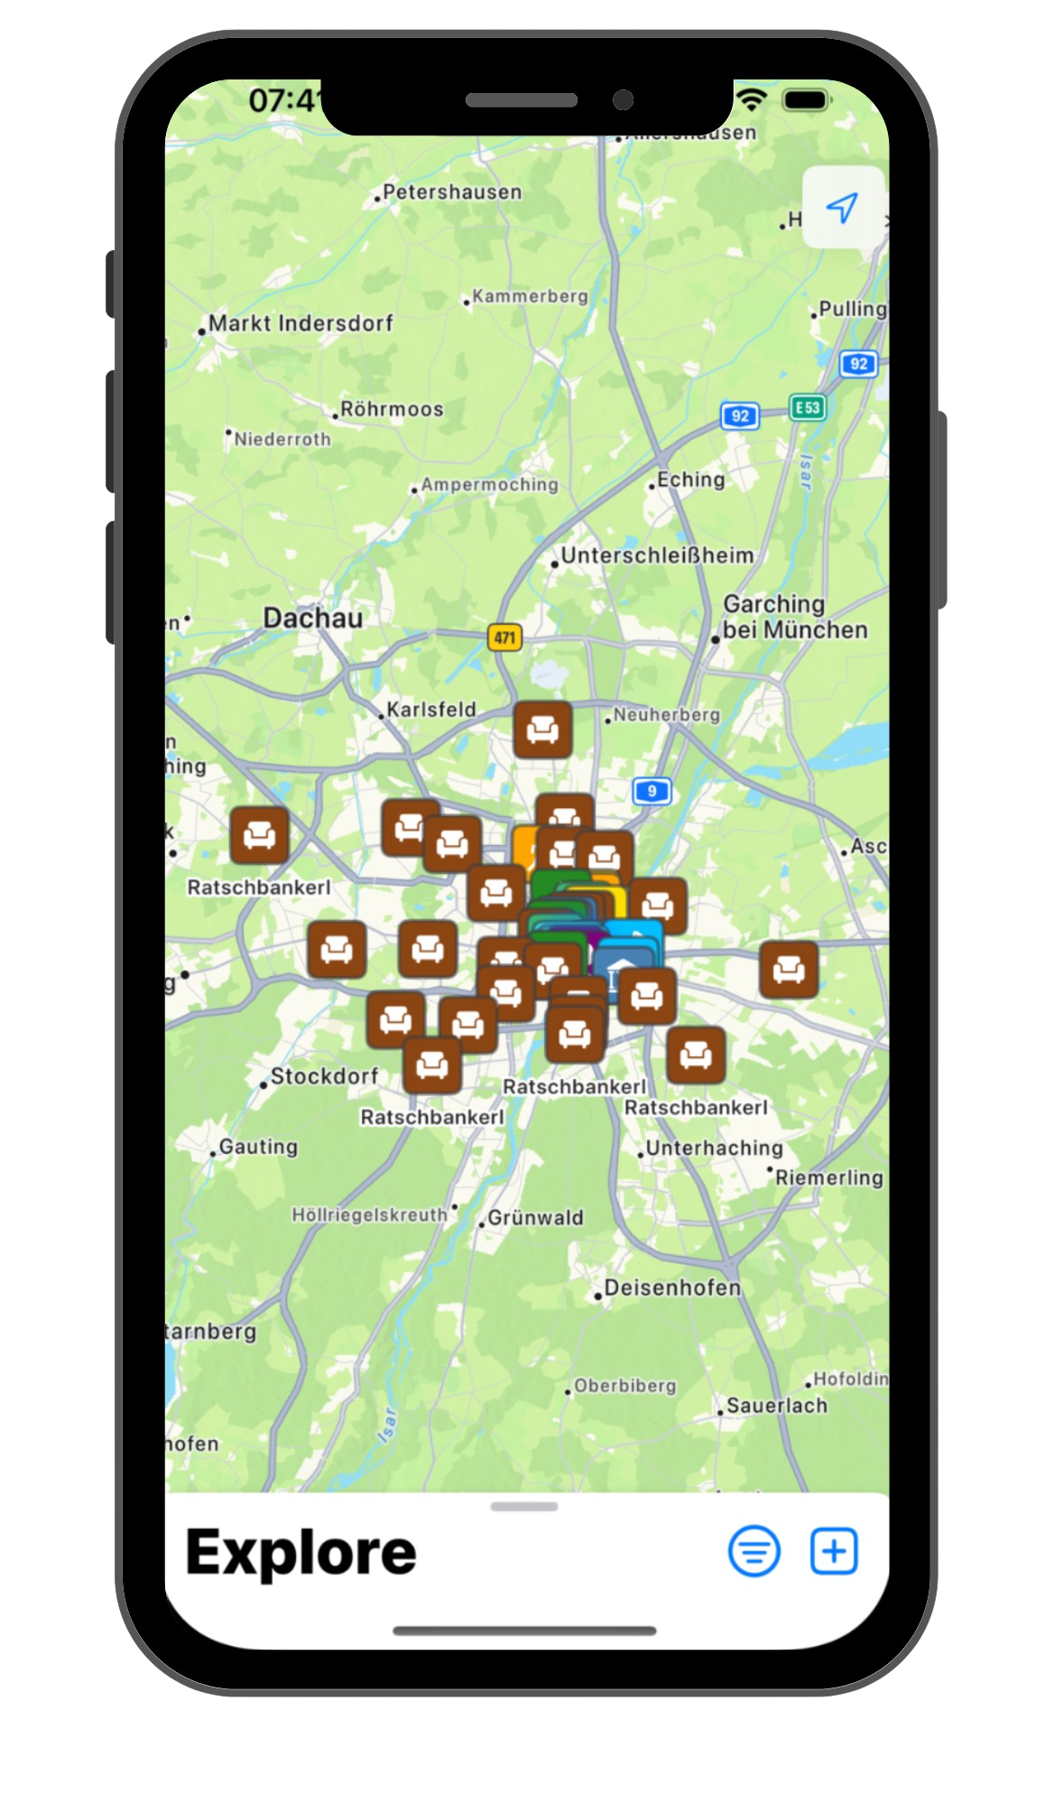
Our vision
Strengthen Communities
Combat Loneliness
Promote Inclusion
Enhance Local Engagement
Supports inclusivity

Slide 3
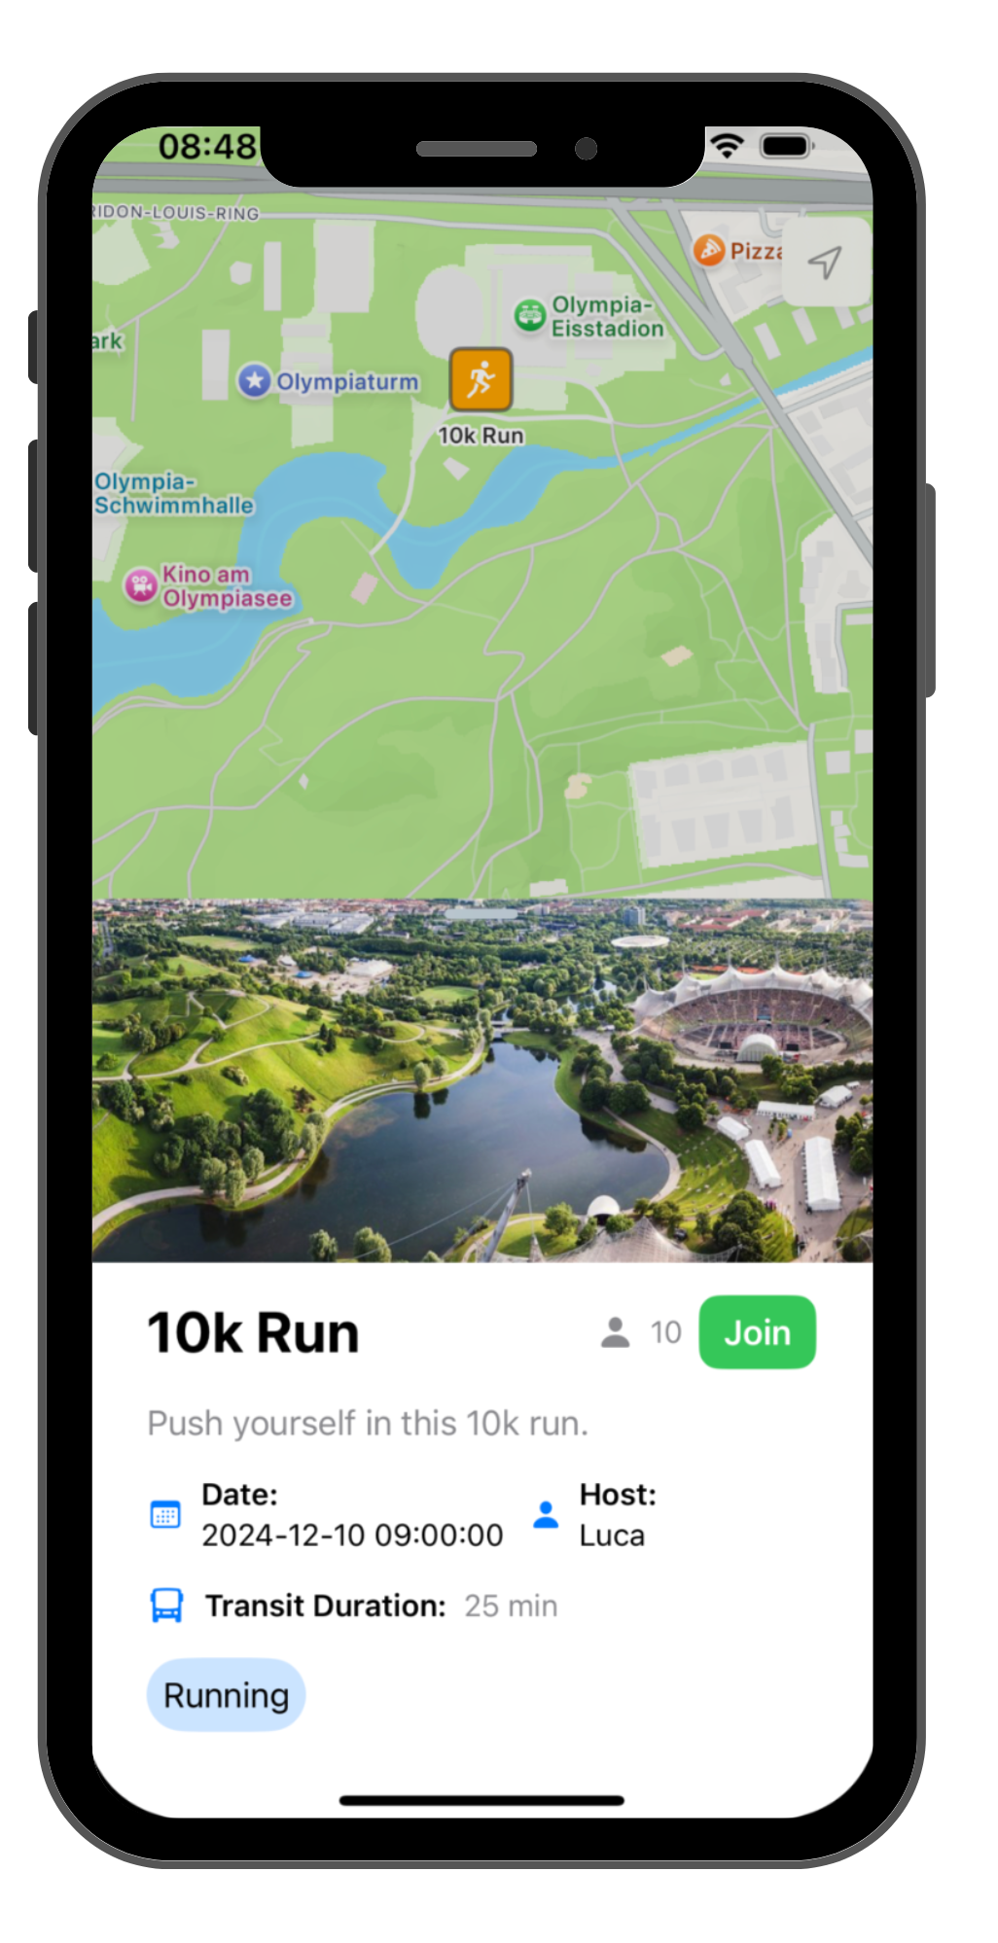
Interactive MAP
01
Discover Events:
Explore a curated list of activities tailored to your interests.
02
Find Activities You Love:
Browse and join events based on categories like: Bouldering, Chess, Museums and more!
03
Simple Interaction:
An intuitive design ensuring accessability for everyone!

Slide 4
EVENTS
01
Join Activities
Access events with a single click and connect with others.
02
Host Events:
Create your own events, from small meetups to large gatherings, and manage them with ease.
03
Data-Driven Matching through ML:
Offers intelligent recommendations using user preferences and event data.

Slide 5
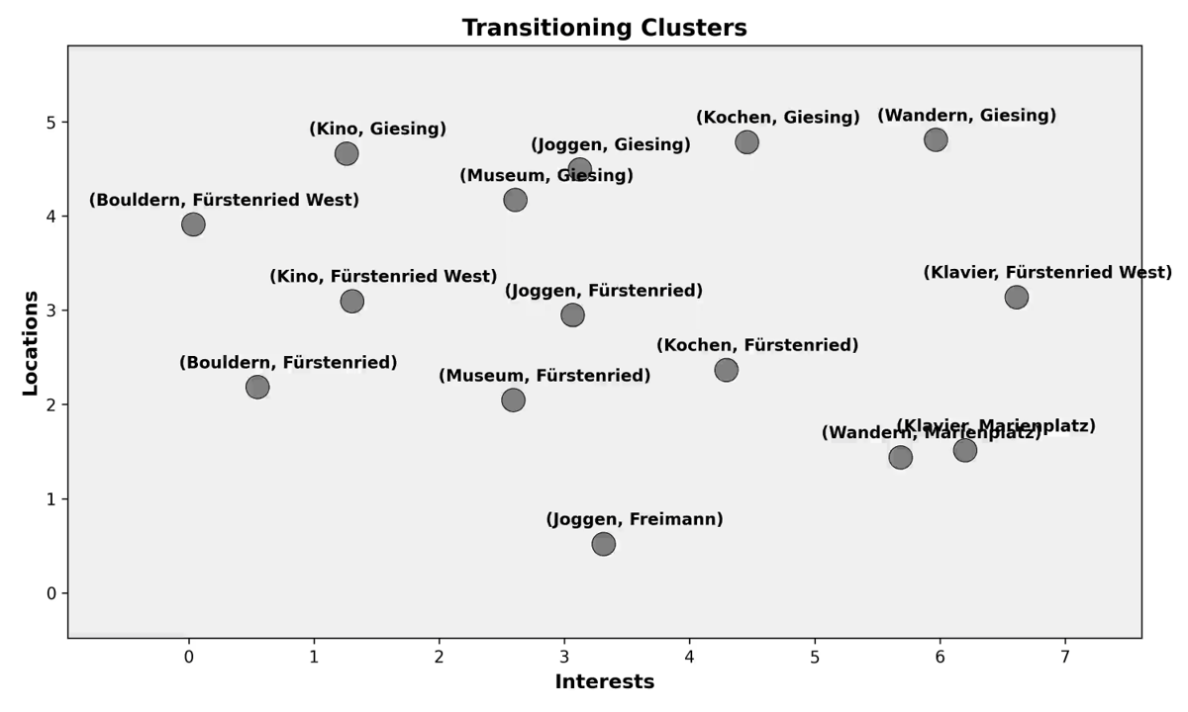
City of Munich
OUR
ALGORITHM

Slide 7


Slide 8
DEMO

Slide 9
City of Munich
Thank You
München, 24.11.2024
Bozzetti, Meierlohr, Vorderbrügge

